Slide 1
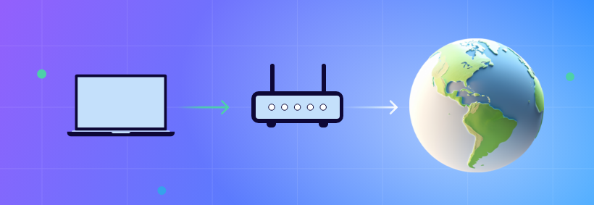
NAT(Network Address Translation)
NAT is a process used by routers to connect devices in a private network to the internet.

Slide 2

IP Address(Internet Protocol address):
An IP address is a unique numerical identifier assigned to each device connected to a network that uses the Internet Protocol for communication.
It serves two main purposes:
Identification
Location Addressing

Slide 3
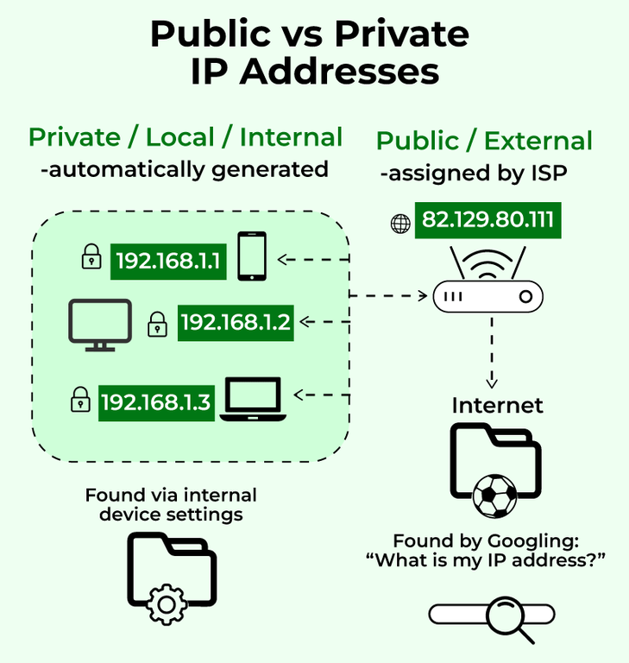
Types of IP
Private: Used within local networks (not accessible from the internet).
Public: Used for devices directly accessible on the internet.

Slide 4
Private IP vs Public IP
Public IP Address:
Assigned by ISPs and used on the internet.
Unique across the globe and accessible from anywhere.
Examples:
203.0.113.45
8.8.8.8
Private IP Address:
Used within local networks (home, office).
Not accessible from the internet.
Examples:
192.168.0.1
10.0.0.1

Slide 5
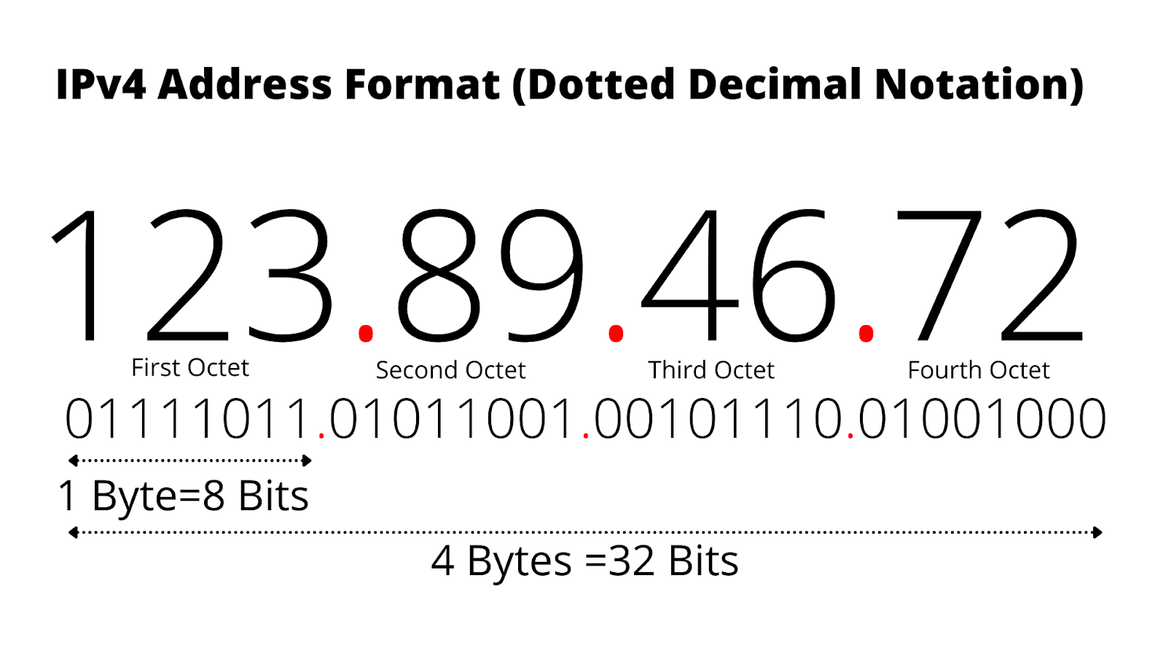
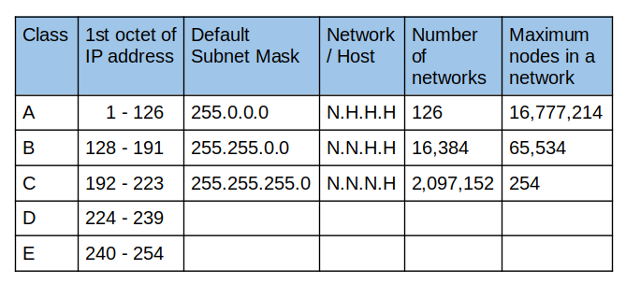
IPV4

Slide 6
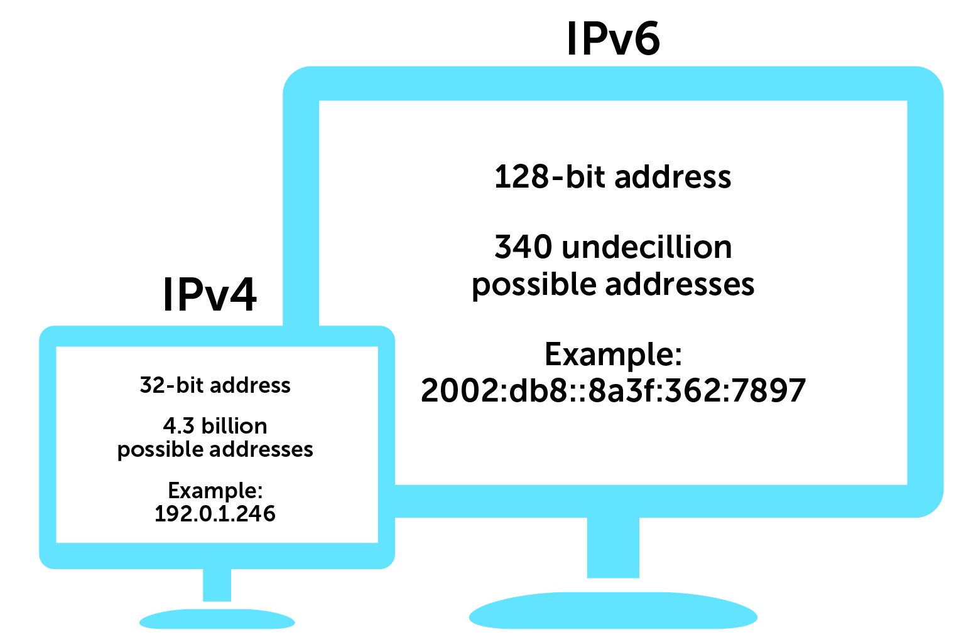
IPV4 vs IPV6

Slide 7
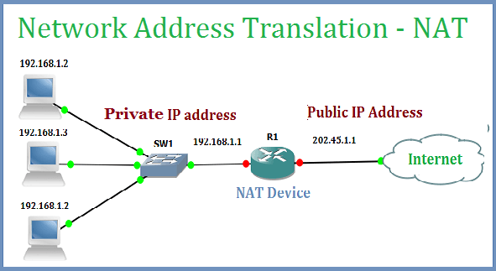
How NAT works:

Slide 8
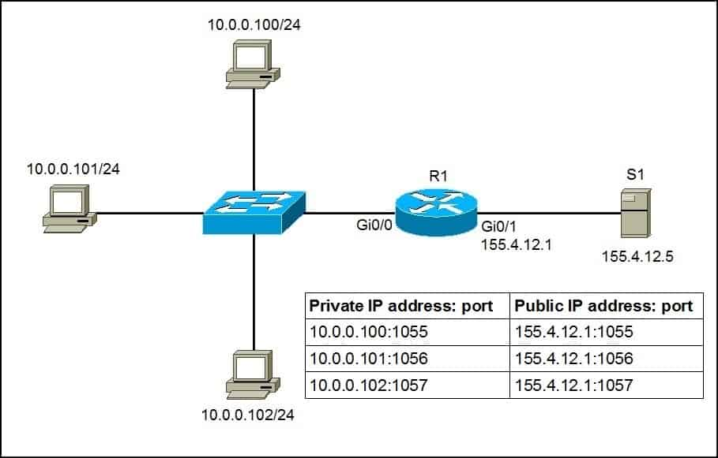
NAT Table

Slide 9
Advantages and Disadvantages of NAT
Advantages of NAT | Disadvantages of NAT
IP Address Conservation | Slower Speed
Enhanced Security | Connectivity Problems
Network Flexibility | Needs Special Tools
Cost Efficiency | Hard to Fix Issues
Ease of Network Expansion | Limited Ports

